Slide 1
Node JS – Step 7

Slide 2
Node JS
Node JS is a run time environment for JavaScript library and framework.
Before node js JavaScript is known as Client side scripting language.
But after node js JavaScript also known as Client side as well as server side scripting language.
Node JS provided lot of pre module which help to create the server side application.
Node JS Modules divided into
Core module
User defined module
External module

Slide 3
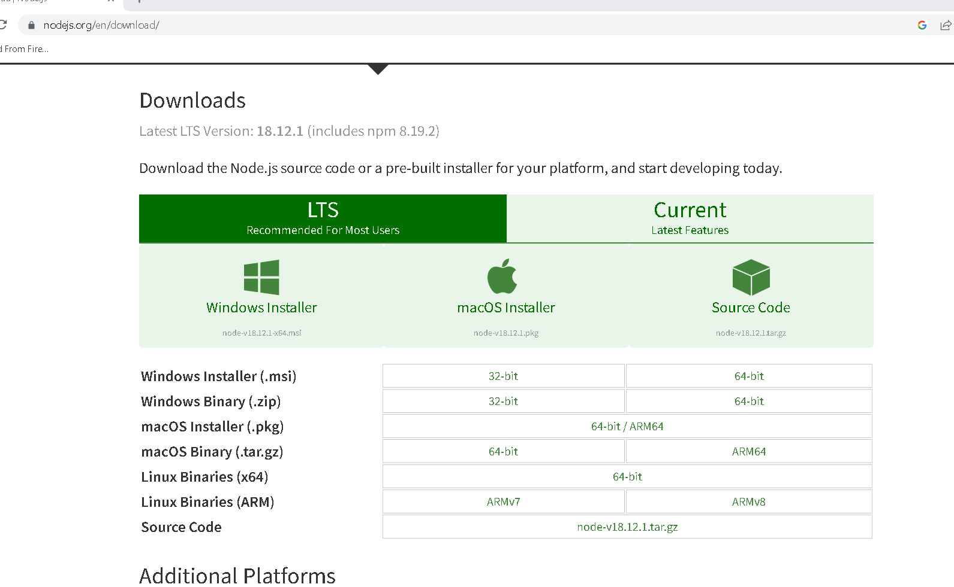
Installation of node js

Slide 4
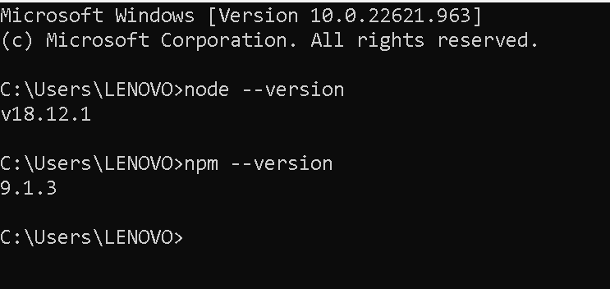
To verify node version and npm version

Slide 5
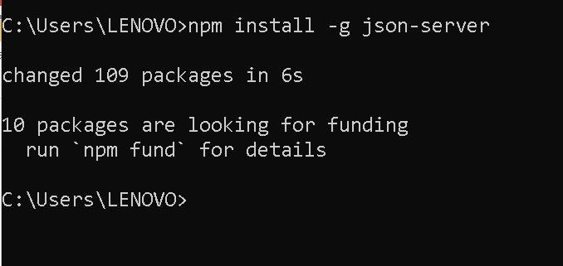
Json-server
json-sever : it is external modules which help to make json static file as a server with default port number 3000.

Slide 6
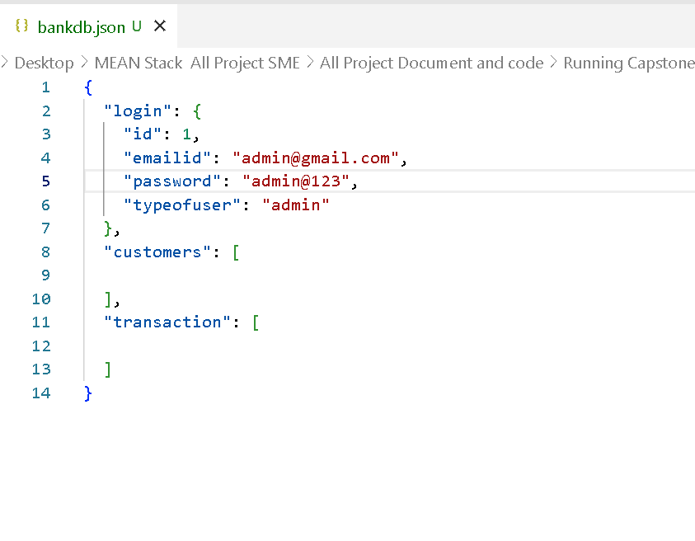
Sample json file bankdb.json

Slide 7
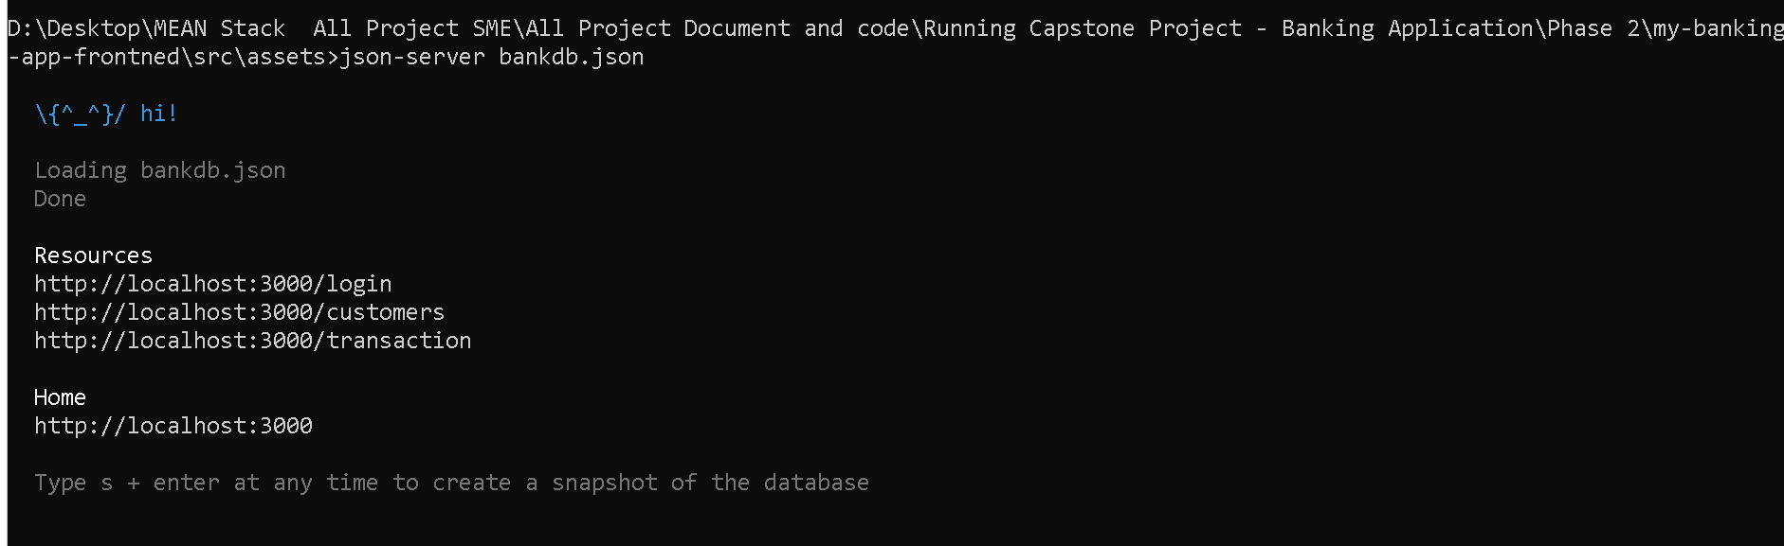
After running json file using json-server

Slide 8
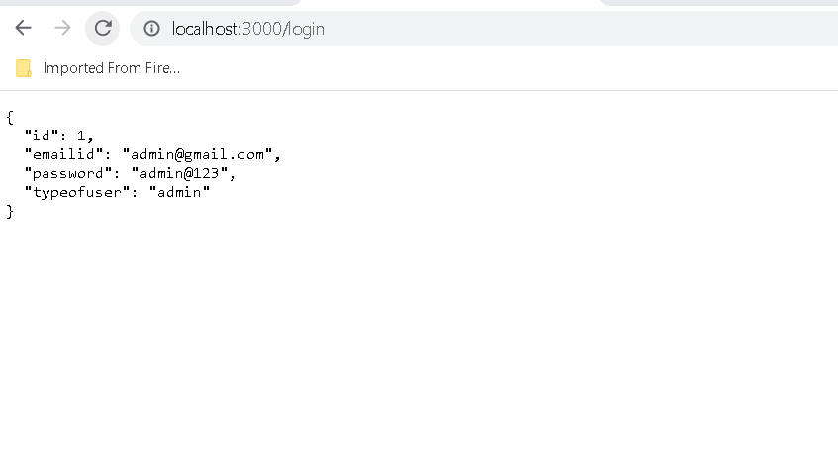
Verifying browser

